Slide 1




Shield Your Family, Employees & Clients
Presenter Info Here

Slide 2

The Best Identity Theft Protection

Slide 3

Your Identity is Your Most Valuable Possession
Identity theft has been one of the top consumer complaints filed with the FTC for over 15 years.
Victims often spending an exorbitant amount of time and money dealing with it.
The criminals are getting smarter.
Breaches happen too often.

Slide 4

Ask Yourself Have you, your employees or clients ever…
Worried about being a victim of identity theft?
Had your personal information at risk?
Lost your wallet?
Feared for the security of medical information?
Worried about entering personal information online?

Slide 5

Impact on Victims You, your employees or your clients…
Problems securing loans
Harassment from debt collectors on debts they do not owe
Possible arrest for crimes committed by an identity thief
Red flags on background checks
Difficulty focusing at work
Increased absenteeism

Slide 6

Identity Theft in America
Identity theft has been one of the top consumer complaints filed with the Federal Trade Commission (FTC) for over 15 years.
According to the Consumer Response Annual Report from the FTC, 55% of the credit or consumer complaints received by the Bureau of Consumer Financial Protection were about incorrect information appearing on credit reports. ¹
¹Consumer Financial Protection Bureau (March 2018). Consumer Response Annual Report.

Slide 7
Offering comprehensive online protection.
Educate your employees and clients about the benefits of purchasing a comprehensive identity theft plan - IDShield
IDShield provides both credit and internet monitoring
IDShield is the ONLY identity theft plan that provides access to private investigators

Slide 8

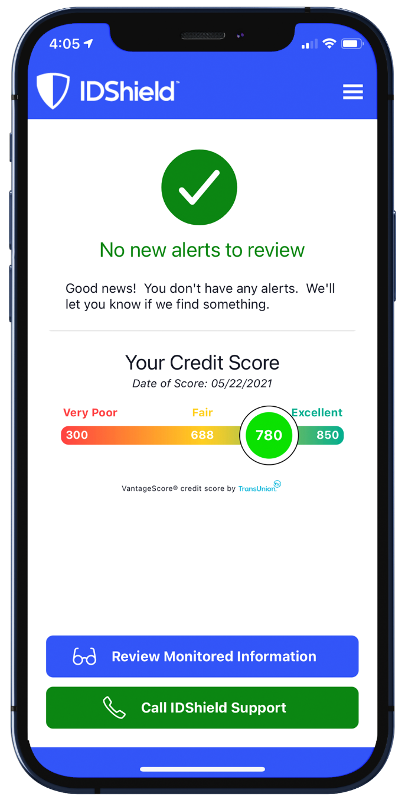
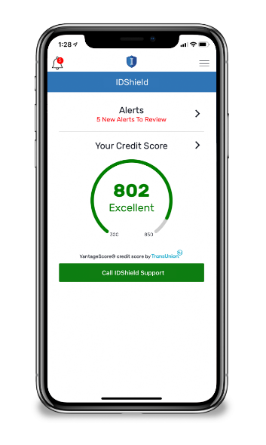
Monitoring & Alerts (Monitor everything that matters)
Credit Score
1B or 3B Credit Bureau Monitoring**
SSN
Passport
Driver’s License
Email*, Phone, DOB
Medical ID*
Username/Password*
Dark Web
Social Media
Financial Threshold Account Monitoring
Receive an alert on financial withdraws, balance transfers & large purchases
Credit Cards
Checking Account
Savings Accounts
401K
Loans
And more!
**1B or 3B Credit Bureau Monitoring depending on the plan *Up to 10
IDShield is a product of Pre-Paid Legal Services, Inc. d/b/a LegalShield ("LegalShield"). LegalShield provides access to identity theft protection and restoration services. IDShield plans are available at individual or family rates. A family plan covers the named member, named member's spouse or domestic partner and up to 10 dependent children under the age of 18. Certain benefits are only available with a 3Bureau identity theft plan and are not offered with a 1Bureau identity theft plan. For complete terms, coverage, and conditions, please see an identity theft plan. All Licensed Private Investigators are licensed in the state of Oklahoma. An Identity Fraud Protection Plan ("Plan") is issued through a nationally recognized carrier. LegalShield/IdShield is not an insurance carrier. This covers certain identity fraud expenses and legal costs as a result of a covered identity fraud event, with the amount of coverage dependent on the type of identity theft plan. See a Plan for complete terms, coverage, conditions, and limitations, and family members who are eligible under the Plan.

Slide 9
New! Trend Micro Maximum Security
The cloud-based AI technology offered by Trend Micro delivers highly effective and proactive protection against ever-evolving malware infections.
New! VPN Proxy One
Convenient protection anywhere you connect, including hotels, cafes, offices, and schools through encrypted communications provided by Trend Micro’s VPN Proxy One. Filters help block malicious websites, online fraud, and internet scams. Full anonymity - no location or online activity tracking. Safeguards provided when you connect to a risky Wi-Fi network.
New! Password Manager
Get multiple device protection and privacy for your digital life.
Helps block dangerous websites
Manages and encrypts passwords
Saves time
Identify and change weak passwords
Gives you control
Creates unique, tough to hack passwords

Slide 10
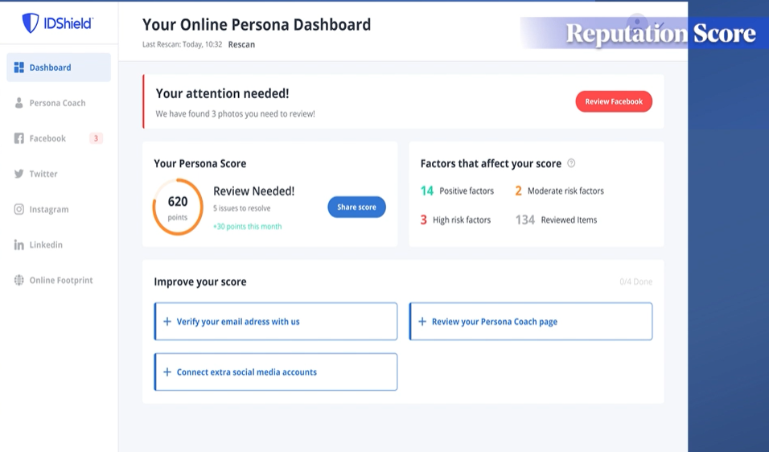
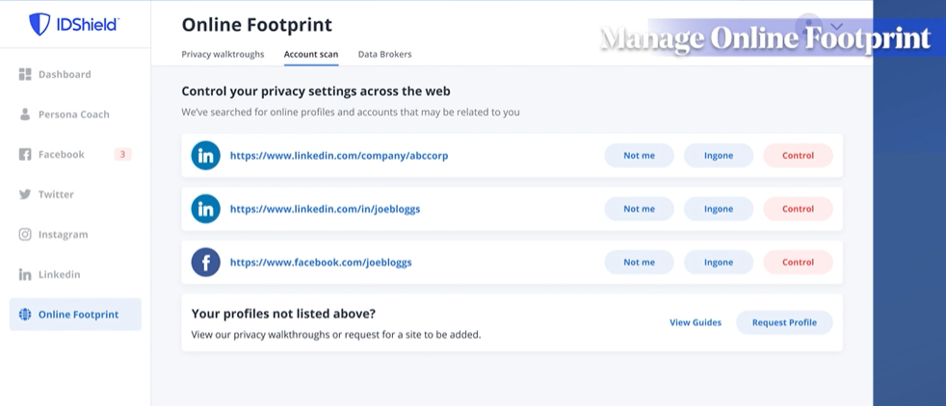
Privacy Reputation Management & Score*
IDShield’s proprietary technology scans for potential reputation-damaging content on social media accounts such as:
Facebook
LinkedIn
Twitter
Instagram
Online Footprint
IDShield is a product of Pre-Paid Legal Services, Inc. d/b/a LegalShield ("LegalShield"). LegalShield provides access to identity theft protection and restoration services. IDShield plans are available at individual or family rates. A family plan covers the named member, named member's spouse or domestic partner and up to 10 dependent children under the age of 18. Certain benefits are only available with a 3Bureau identity theft plan and are not offered with a 1Bureau identity theft plan. For complete terms, coverage, and conditions, please see an identity theft plan. All Licensed Private Investigators are licensed in the state of Oklahoma. An Identity Fraud Protection Plan ("Plan") is issued through a nationally recognized carrier. LegalShield/IdShield is not an insurance carrier. This covers certain identity fraud expenses and legal costs as a result of a covered identity fraud event, with the amount of coverage dependent on the type of identity theft plan. See a Plan for complete terms, coverage, conditions, and limitations, and family members who are eligible under the Plan.
Notes:
It’s Important to safeguard how you look online with IDShield’s NEW Reputation Management Experience – these automated tools manage your social media presence and build a successful online profile! And keep it that way!

Slide 11

Comprehensive Restoration
$1 Million Identity Fraud Protection Plan
Licensed Private Investigators will:
Do whatever it takes.
Work as long as it takes.
Restore identity to its pre-theft status.
(IDShield for Business Available)
Notes:
Both 1B and 3 Bureau Plans now have the $1Million Identity Fraud Protection Plan

Slide 12
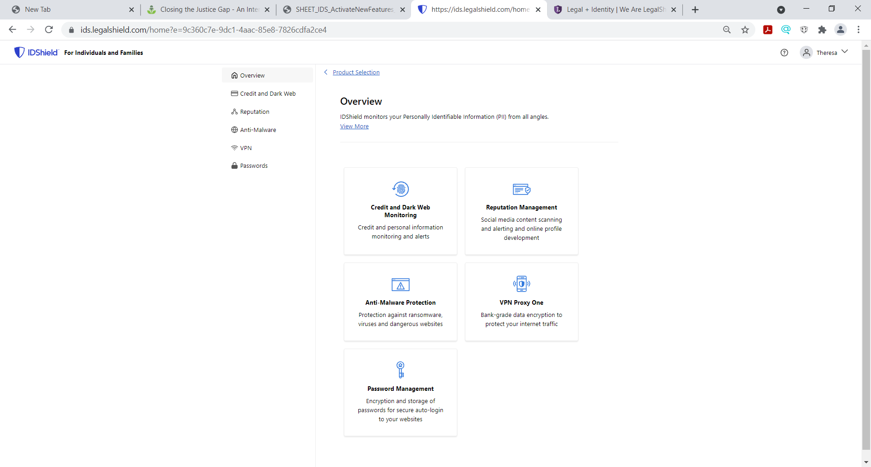
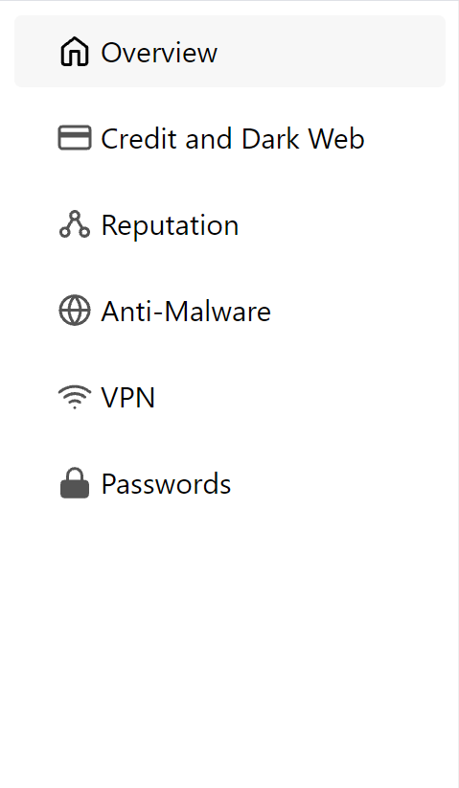
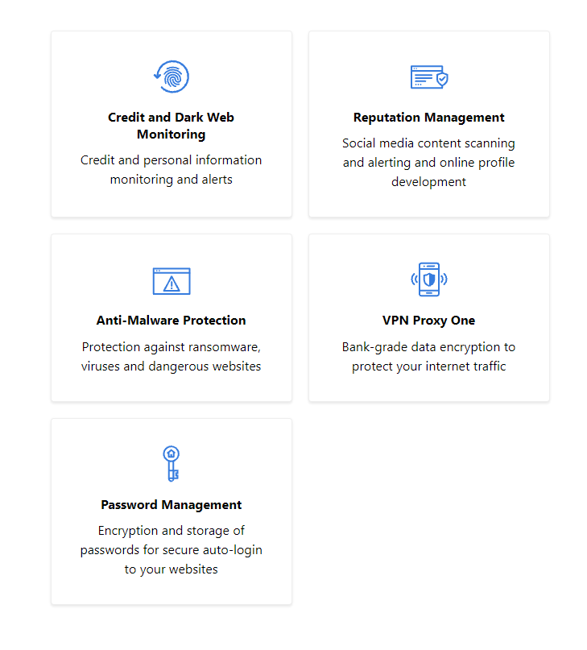
New IDShield Portal!
New IDShield Members (starting Oct.1)
Two points of navigation to set up benefits
Notes:
Starting October 1, New IDShield members will be directed to the New IDShield Portal (ids.legalshield.com) to activate their services!

Slide 13

Ranked #1 by Forbes

Slide 14


Who’s Covered?
Individual plan
The member
Family plan
The member
The member’s spouse or domestic partner and up to 10 dependent children under the age of 18.
It also provides consultation and restoration services for dependent children ages 18 to 26.

Slide 15
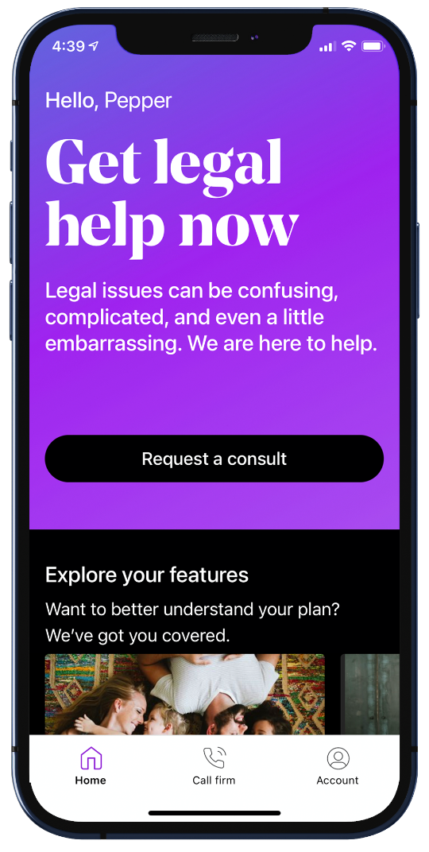
New Dual Plan LegalShield + IDShield Benefit!
Notes:
For our:
IDShield Member:
By adding LegalShield for ($29.95/price) to your IDShield Plan, you will receive the Bonus benefits of Credit Counseling and Education. These benefits include advice from our certified professional counselors on managing your finances and monthly expenditures to maintain or develop a healthy credit score. Your LegalShield provider law firm will now advocate for you in the complicated world of credit reporting, including sending a letter to the credit bureaus on your behalf if a bona fide error is found. These benefits are only available to those who purchase the LegalShield and IDShield plan together. The Dual LegalShield and IDShield Plan will give you peace of mind with full-service support for all of your credit related matters.
For our LegalShield Member or someone interested only in LegalShield
LegalShield Member: By adding IDShield for ($29.95/price) to your LegalShield Plan, you will receive the Bonus benefits of Credit Counseling and Education. These benefits include advice from our certified professional counselors on managing your finances and monthly expenditures to maintain or develop a healthy credit score. Your LegalShield provider law firm will now advocate for you in the complicated world of credit reporting, including sending a letter to the credit bureaus on your behalf if a bona fide error is found. These benefits are only available to those who purchase the LegalShield and IDShield plan together. The Dual LegalShield and IDShield Plan will give you peace of mind with full-service support for all of your credit related matters.
When you are selling the dual Plan
LegalShield + IDShield Member: With a dual plan membership of LegalShield and IDShield, you now receive the Bonus benefit of Credit Counseling & Education. With this new benefit you will get advice on managing your finances to maintain or develop a healthy credit profile. In addition, your LegalShield provider law firm will now advocate for you in the complicated world of credit reporting, including sending a letter to the credit bureaus on your behalf if a bona fide error is found. These benefits are only available to those who purchase the LegalShield and IDShield plan together. The New Dual LegalShield and IDShield Plan will give you peace of mind with full-service support for all of your credit related matters.

Slide 16

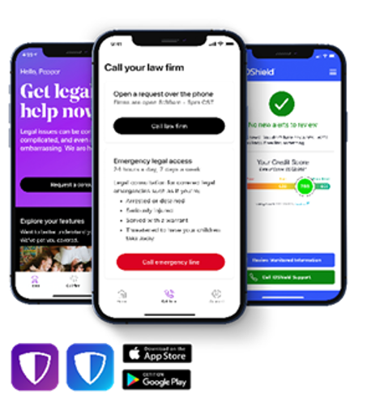
Credit Counseling and Education
Dual LegalShield and IDShield Members receive the additional benefit of Credit Counseling and Education
Advice on managing your finances to maintain or develop healthy credit.
Your LegalShield Law Firm will advocate for you in the complicated world of credit matters, including sending a letter to the credit bureaus on your behalf when a bona fide error is found on your credit report.
The New Dual LegalShield and IDShield Plan will give you peace of mind with full support for all credit related matters.
Notes:
With a dual plan membership of LegalShield and IDShield, you now receive the Bonus benefit of Credit Counseling & Education. With this new benefit you will get advice on managing your finances to maintain or develop healthy credit. In addition, your LegalShield provider law firm will now advocate for you in the complicated world of credit matters, including sending a letter to the credit bureaus on your behalf when a bona fide error is found. These benefits are only available to those who purchase the LegalShield and IDShield plan together. The New Dual LegalShield and IDShield Plan will give you peace of mind with full-service support for all of your credit related matters.

Slide 17
LegalShield + IDShield Dual Plan Credit Counseling and Education
Receive counseling on:
Debt management
Financial budgeting
Actions that impact your credit rating
Identity Theft Risk Management
Reducing exposure to identity theft
How new credit report entries can impact credit ratings
How credit scores influence loans and interest rates
Causes of credit score changes
How collections and inquiries affect credit reports
Reviewing suspicious activity
How to build credit
Home buying coaching
Mortgage Risks and Education
Creating a Budget
Spending Habits
How debt settlement affects credit score
Understanding credit card APR
Please note: The Credit Counseling and Education feature is for Dual Plans only.
Notes:
Our identity theft specialists will provide one-on-one education to help you understand your valuable credit rating and actions that are likely to have an impact on your credit score. Lenders and creditors check your financial info and submit their findings to your credit report. A bad credit score could lead to higher payments for products, loans, insurance, debts and mortgage applications.
By combining your legal plan credit benefits with your IDShield credit counseling and education benefits, you get full-service support for credit related matters. With this full-service credit approach, we review your expenditures to help you identify unnecessary spending habits that could negatively affect your credit rating. We look at your expenses to help determine if you are paying for services you don’t need. If you already Subscribe to Netflix and Hulu, do you really need that third streaming service subscription? Are you paying for the premium phone plan when a cheaper tier will do? By analyzing your payments, we can help you trim the fat that could lead to a bad credit rating.
Receive counseling on:
Debt management – Offer education on healthy debt management and how to follow a spending plan.
Financial budgeting - Provide information to assist customers in creating a budget.
Actions that impact your credit rating – Educate on actions that can impact credit ratings, understanding those ratings and how they can influence interest rates.
Identity Theft Risk Management – Guidance on how to mitigate the risks of identity theft. Including how to block unwanted calls and texts, awareness of circulating scams, ploys to gain access to personal information and phishing awareness.
Reducing exposure to identity theft – Offer Privacy Management and Reputation Management alongside additional tools available through the IDShield Membership to proactively reduce risks.
How new credit report entries can impact credit ratings - Educate consumers on best practices when applying for credit to limit any negative impacts.
How credit scores influence loans and interest rates – Explain how credit score is used to determine if a consumer is a risk when extending credit. In addition, the credit score is used to help determine the interest rates and fee’s financial entities charge, based on the determined credit risk
Causes of credit score changes – Education as to what components can lead to changes in a credit score. These include, but are not limited to, debt to credit ratio, payment history and different scoring systems or algorithms.
How collections and inquiries affect credit reports - Credit activity can impact a consumer's score in a positive or negative way. For example, hard inquiries and collections will decrease your score by as little as 5 points and up to 110 points. We will educate consumers on best practices when applying for credit to limit any negative impacts.
Reviewing suspicious activity - Assistance in reviewing any suspicious activity reported by the service with coaching and education on how to determine the difference between legitimate and suspicious activity.
How to build credit – Share tips on how to build a strong credit file such as keeping a low balance, paying on time and maintaining a low credit ratio.
Home buying coaching- Education and consultation on purchasing a home to offer understanding on how to work on credit issues, understanding the various loan terms, interest rates and how your credit plays into the overall process.
Mortgage Risks and Education - Guidance on understanding the various loan terms, interest rates and how your credit plays into the overall process.
Creating a Budget - Coaching on how to calculate monthly income, pick a budgeting method and monitor your progress to help you decide what to spend each month.
Spending Habits - Assistance in tracking spending habits and coaching in how to improve those habits to best position the consumer for financial stability.
How debt settlement affects credit score - Educate customers on how debt settlement impacts a credit score short and long term, potential outcomes of settling for a lesser amount, and how this impacts a person in the future.
Understanding credit card APR- Understand what APR is and how it factors into your monthly payments on borrowed monies.

Slide 18
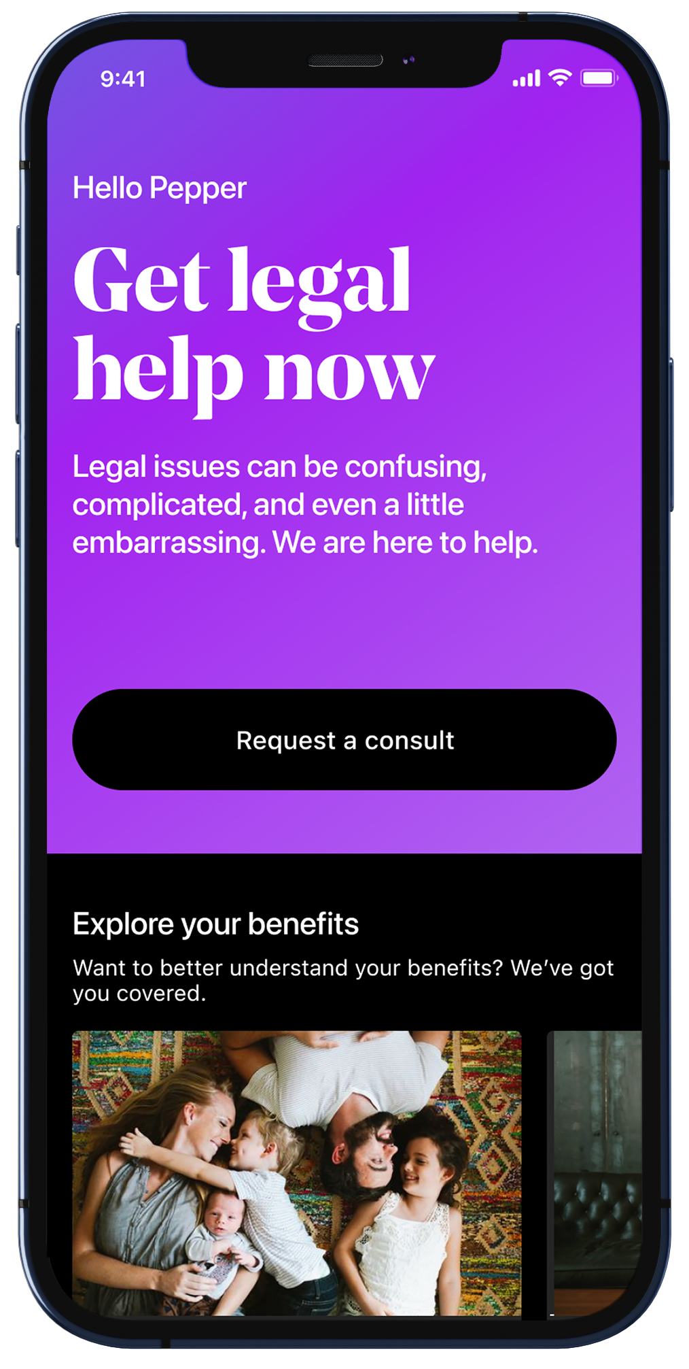

Benefits:
Personal Legal Advice on unlimited issues
24/7 Emergency Access for covered situations
Letters/Calls made on your behalf
Contracts/Documents reviewed, up to 15 pages each
Lawyers prepare your Will/Living Will/Health Care Power of Attorney
Traffic Related Issues
IRS Audit Assistance
Trial Defense
Family/Domestic Services*
25% Preferred Member Discounts
LegalShield Benefits
A law firm in the palm of your hand!
*90 Day waiting period applies. Limitations may apply. Service and benefits vary by state/province.
Please review contract for complete terms, conditions and limitations before purchase.

Slide 19
IDShield | Group Rates (monthly)
Family IDShield | $22.95
Individual/Employee Only | $12.95
Family - LegalShield & IDShield Dual | $41.90
Individual – LegalShield & IDShield Dual | $34.90

Slide 20


Group MEMBERPerks can be found via direct link at: https://legalshield.perkspot.com/login
These benefits are for LegalShield and IDShield members. All offers or promotions are subject to change without notice.

Slide 21
IDShield 3 Bureau Credit Monitoring Option

Slide 22

3B IDShield
IDShield 3B monitors all 3 major credit bureaus
TransUnion
Equifax
Experian
Notes:
3 Bureau Credit Monitoring.
3 Bureau (or 3B monitoring) is just what it sounds like: We monitor all 3 credit bureaus—TransUnion, Equifax and Experian—to give members a complete picture of what’s on their credit report.
Why is 3B monitoring so important? As you know, lenders, creditors and many businesses check your financial data and submit their findings to your credit report.
HOWEVER, not all report to the same credit bureau and they don’t always report accurately. Errors on your credit report could lead to higher payments for products such as loans and car insurance, false debts, and problems with mortgage applications
According to the latest study on credit report accuracy from the Federal Trade Commission, 55% of the credit or consumer complaints received by the Bureau of Consumer Financial Protection, were about incorrect information appearing on credit reports.
IDShield monitors all 3 major credit bureaus to give them total awareness. It alerts members to any changes and provides a comprehensive view of their valuable credit standing.
IDShield provides members with instant threat alerts through comprehensive monitoring. If a data breach occurs, members have 24/7 access to Licensed Private Investigators who will do everything it takes for as long as it takes to ensure identity restoration. We also provide a one million dollar insurance policy to cover any losses that result from a data breach.
We also provide a one million dollar insurance policy to cover any losses that result from a data breach.
. If a data breach occurs, members have 24/7 access to Licensed Private Investigators who will do everything it takes for as long as it takes to ensure identity restoration. We also provide a one million dollar insurance policy to cover any losses that result from a data breach.

Slide 23
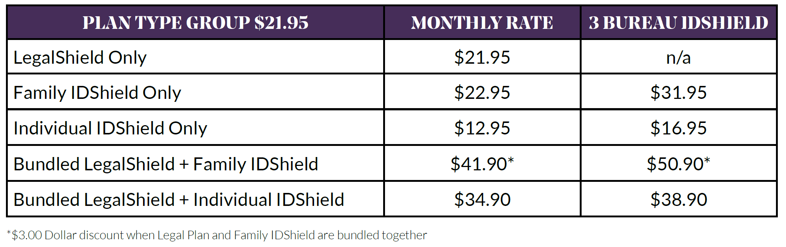
IDShield 3 Credit Bureau Pricing

Slide 24

Growth of Cybercrime
Cybercrime Is On The Rise
Cyberattacks are up 400% since March 2020 ²
Email attacks up 600% ³
43% of online attacks now aimed at Small Businesses, but only 14% are prepared to defend themselves. ¹
1 https://www.cnbc.com/2019/10/13/cyberattacks-cost-small-companies-200k-putting-many-out-of-business.html
2 https://securitybrief.eu/story/covid-sees-400-surge-in-cyber-crime
3 https://thehill.com/policy/cybersecurity/489692-experts-see-over-600-percent-spike-in-malicious-emails-during
Notes:
Cybercrime is on the rise, the coronavirus accelerated it immensely.
Cyberattacks are up 400% since March 2020 ²
With 43% of online attacks now aimed at small businesses, a favorite target of high-tech villains, yet only 14% prepared to defend themselves, owners increasingly need to start making high-tech security a top priority, according to network security leaders.
Today it is critical for Small Businesses to adopt strategies against cybercriminals and IDShield for Business is one of them. A business can’t simply rely on antivirus software to protect them as most reported cyberattacks can blast through end point protection (anti-virus software).

Slide 25

Growing Need for Small Business Cyber protection
A Cyberattack can damage more than your business network
IDShield For Business provides the essentials layers every business needs to identify, protect, detect, respond and recover from a cyberattack.
Notes:
Cybercrime has become a large concern for the business sector. Small businesses and midsize/midmarket companies tend to be attractive to cybercriminals because they are perceived as “easy” targets that lack the capability and resources to help identify online threats to their business.
IDShield for Business addresses one of the top issues that keeps small business owners up at night: How to mitigate risk and recover from a cyberattack.
The financial cost can be staggering. Like personal identity plans, IDShield for Business includes a protection plan for covered losses – including legal and forensic expenses, fraud response, public relations fees that arise from a cyberattack, and losses due to ransomware, social engineering and more. However, it is designed specifically to protect small business in the event of a cyberattack and our emergency help line means we’re there when needed.
There are also repercussions beyond financial losses. Many small and midsize companies have business dealings with larger organizations. Therefore, any security incident can have far-reaching effects on clients and partners. A company’s entire operation can be disrupted by an attack, and it could take a long time to recover — or even worse, never recover at all.

Slide 26

Cybersecurity – Who Needs it?
The Facts:
76% cyberattacks were inflicted upon companies with less than 100 people. ¹
Each new vulnerability discovered increases your level of risk.
88% of small business owners feel vulnerable to cyberattacks.
1 Keeper Security (Nov. 2018) 2018 State of Cybersecurity in Small & Medium Size Businesses. Retrieved from https://www.keepersecurity.com/assets/pdf/Keeper-2018-Ponemon-Report.pdf
Notes:
76% of cyber attacks were inflicted upon companies with less than 100 people.¹ - With so much at risk, it is imperative to stay vigilant in detecting and addressing security holes or misconfigurations in your systems. Each new vulnerability discovered increases your level of risk, as attackers can often figure out how to exploit these vulnerabilities within days (or sometimes even hours) of their discovery.
Businesses report over $1.7 billion in losses annually due to compromised emails alone.³
3 -https://www.hipaajournal.com/1-77-billion-was-lost-to-business-email-compromise-attacks-in-2019/

Slide 27

IDShield For Business
Protecting & Empowering Small Businesses For More Than 40 years
Vulnerability Scans
Technical Assistance
Emergency Helpline Response
$100K Cyber- Protection Plan
Notes:
The IDShield for Business For Business Plans cover:
Vulnerability Scans: Comprehensive, automated monthly scans and vulnerability reports of your networks.
Remote Technical Assistance: Professional help resolving cyber risks.
Emergency Service Response: Emergency access to Cybersecurity Incident Response Specialists if your business experiences a11
cyberattack.
$100K Cyber-Protection Plan: Coverage for losses incurred as a result of a cyberattack.
Crisis Management up to $100K

Slide 28
IDShield For Business
Essentials & Plus Plans
IDShield For Business Essentials Plan $79.95
Protects up to 6 URLS
and/or Public IP Addresses
IDShield For Business Plus Plan $149.95
Protects up to 12 URLS
and/or public IP Addresses
Notes:
Small Business Cybersecurity Program that will not break the bank or bankrupt your business; it could possibly save your business from bankruptcy!!

Slide 29
LegalShield
Established 1972
We are the largest group legal and identity theft plan provider in North America
We are the only company that offers both a comprehensive legal and identity theft plan
We serve over 3 million lives, over 30,000 employer groups and 48,000 small businesses

Slide 30



Flexible Enrollment, Payment, and Billing Options
Enrollment Options
Payment Options
Web
Electronic
Paper
Onsite Enrollers
Self Pay / Bank Draft
Checking
Savings
Credit Card
Payroll Deduction
Partial Fringe
Fringe
Billing Options
Electronic
Self
Paper

Slide 31
Thank you for your time today!
LegalShield provides access to legal services offered by a network of provider law firms to LegalShield members through membership based participation. Neither LegalShield nor its officers, employees or sales associates directly or indirectly provide legal services, representation or advice. See a plan contract at www.legalshield.com for specific state of residence for complete terms, coverage, amounts and conditions.
IDShield is a product of Pre-Paid Legal Services, Inc. d/b/a LegalShield (“LegalShield”). LegalShield provides access to identity theft protection and restoration services. For complete terms, coverage and conditions, please see www.idshield.com. IDShield plans are available at individual or family rates. A family rate covers the named member, named member’s spouse and up to 10 dependent children under the age of 18. It also provides consultation and restoration services for dependent children ages 18 to 26. All Licensed Private Investigators are licensed in the state of Oklahoma. A $1 million insurance policy is issued through a nationally recognized carrier. LegalShield/IDShield is not an insurance carrier. Certain limitations apply. Dependent children of the named member or named member’s spouse under the age of 23 who permanently live in the same residence as the named member at the time of the stolen identity event are eligible for the insurance policy coverage. For a summary description of benefits for the policy see https://idshield.cloud/summary-of-benefits.
Marketed by: Pre-Paid Legal Services, Inc. dba LegalShield® and subsidiaries; Pre-Paid Legal Casualty, Inc.; Pre-Paid Legal Access, Inc.; LS, Inc.; In VA: Legal Service Plans of Virginia; and PPL Legal Care of Canada Corporation

